Slide 1


Presentation on:
N-Queen Problem
Course Title: Algorithms
Course Code: CSE246
Semester: Summer 2023
Section:02
Group: 10
Group Members:
Jubaer Ahmed: 2021-2-60-139
Mobashhira Jahan: 2020-1-60-282
Instructor:
Md. Mohsin Uddin, Senior Lecturer
Department of Computer Science and Engineering.
Date: 30 August, 2023

Slide 2

Objectives :
What is N-Queen problem?
How to solve this problem?
Basics of Backtracking and its use in N-Queen problem
What complexity does it hold?
Real life scenario regarding N-queen problem

Slide 3
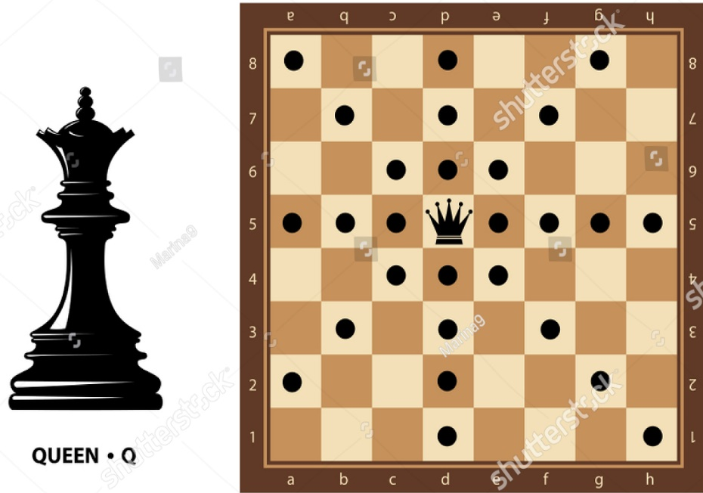
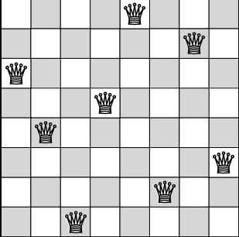
Description of N-Queen Problem:
The N-Queen problem involves placing N chess queens on an NxN chessboard without any two queens attacking each other.
Solution of 8-Queen problem:

Slide 4

How Does This Problem Work?
Here we will find the N-Queen solution for 4x4 chessboard:
 | 0
0
0
Now, we move to column + 1

Slide 5
How Does This Problem Work?
Place the queen in the next safe spot and again move to column + 1 from the first placed queen
When no safe place found in the next column, move to row + 1
0
0
 | 0
0

Slide 6
How Does This Problem Work?
But for the next queen placement, there is no safe place in the column to place the queen. So we will backtrack.
 | 0
0

Slide 7
What is Backtracking?
 | 0
0
Backtracking is a concept where recursive calling is used to find a valid solution step by step by increasing values with time
0
 | 0
0

Slide 8
How Does This Problem Work?
After finding a valid place for the queen, place the queen and again do column + 1 from the first placed queen
 | 0
0
 | 0
0

Slide 9
How Does This Problem Work?
If no safe place found in that column, keep backtracking.
 | 0
 | 0
0
 | 0
0

Slide 10
How Does This Problem Work?
Continue backtracking until finding a safe place for queen
Here we found a safe place for queen in second row.
0
 | 0
0
 | 0

Slide 11
How Does This Problem Work?
 | 0
 | 0
 | 0

Slide 12
The Possible solutions for 4x4 chessboard:
 | 0

Slide 13
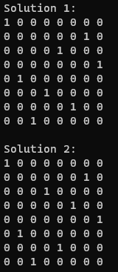
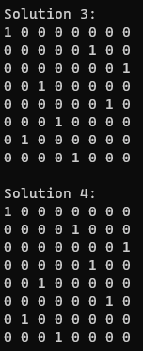
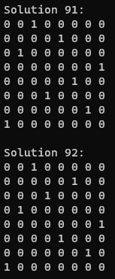
The Sample Outputs:

Slide 14
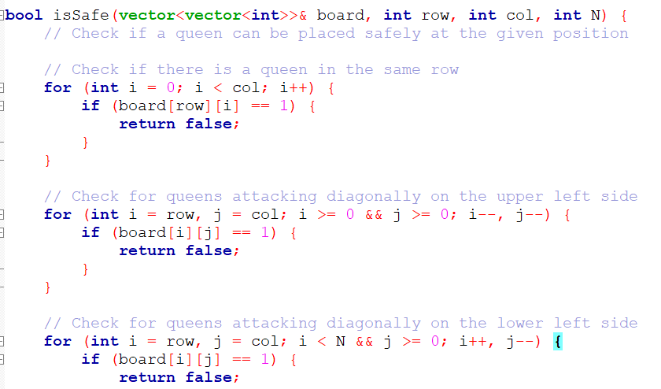
Complexity of N-Queen Problem:
Time complexity:
‘isSafe() = O(N)’
O(N)
O(N)
O(N)
Total complexity O(N) + O(N) + O(N) = O(N).

Slide 15
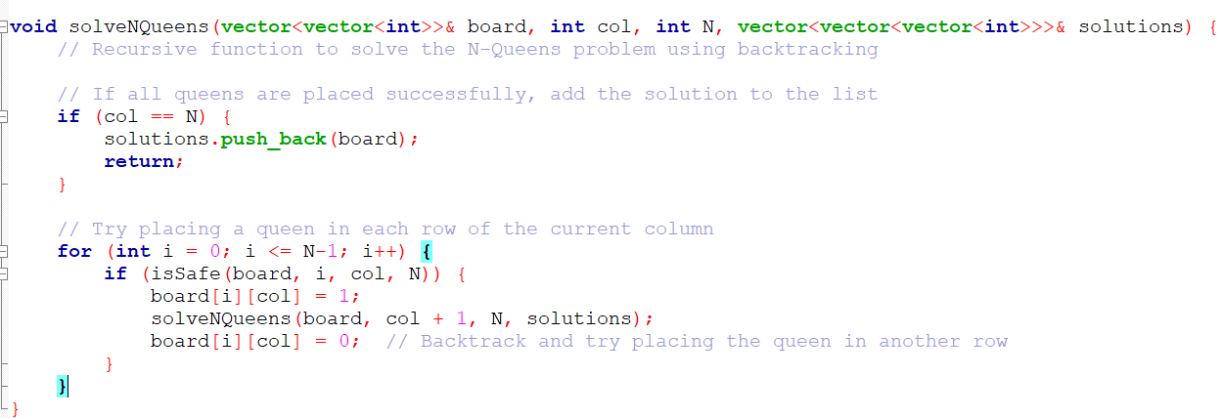
Complexity of N-Queen Problem:
‘solveNQueen() = O(N!)’
O(N)
O(N^2)
O(N)
N x (N-2) x (N-4) x ... X 1 = N!
Total complexity O(N!)

Slide 16
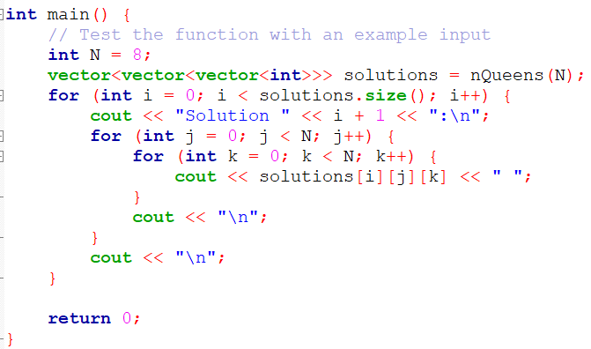
Complexity of N-Queen Problem:
‘main() = O(S*N^2)’
O(N!)
O(S)
O(S*N^2)
O(N^2)
O(N!)
Total Time Complexity of N-Queen problem is O(N!).

Slide 17
Complexity of N-Queen Problem:
Memory Complexity:
Board N*N O(N^2)
Solution O(S*N^2)
Function Call Stack O(N)
Possible complexity O(S * N^2 + N^2 + N)
Total Approximate Complexity O(S*N^2).

Slide 18
Application of N-Queen Problem in real life:
There are some real-life uses of this N-queen's problem, which may not cover all the aspects but it might work generally to establish the same goal as this problem. Some relatable application we considered are:
Course scheduling in universities
Library bookshelf arrangement
Task scheduling in parallel computing

Slide 19
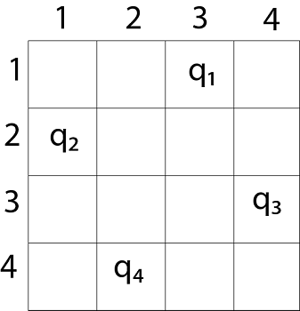
Application of N-Queen Problem in real life(course scheduling):
Take course as queen and time slot as row.
NxN grid model, where N is number of courses.
Assign each course (queen) to a time slot (row) such that no two courses with a significant overlap occurs

Slide 20
Conclusion:
We faced an issue with the column handling in recursive algorithm
We faced an issue with minimizing complexity of the program
To implement a solution to the N-Queen problem, we needed to understand and then apply the backtracking algorithm to solve the problem

Slide 21
Thank You!

